Slide 1
IoT platform

Slide 2
Overview
Examine IoT backend software, multilayer IoT platform
Big data in IoT
Data analysis in IoT

Slide 3
The backend of an IoT solution
Provides the integration layer for connected end devices
Collects data from sensor devices
Routes control commands back to actuators
Saves data for long-term storage, and forward relevant information to frontend applications
IoT platform plays a role as a backend software.

Slide 4
IoT platform
An IoT platform is a multi-layer system that enables provisioning, management, and automation of connected devices within the Internet of Things

Slide 5
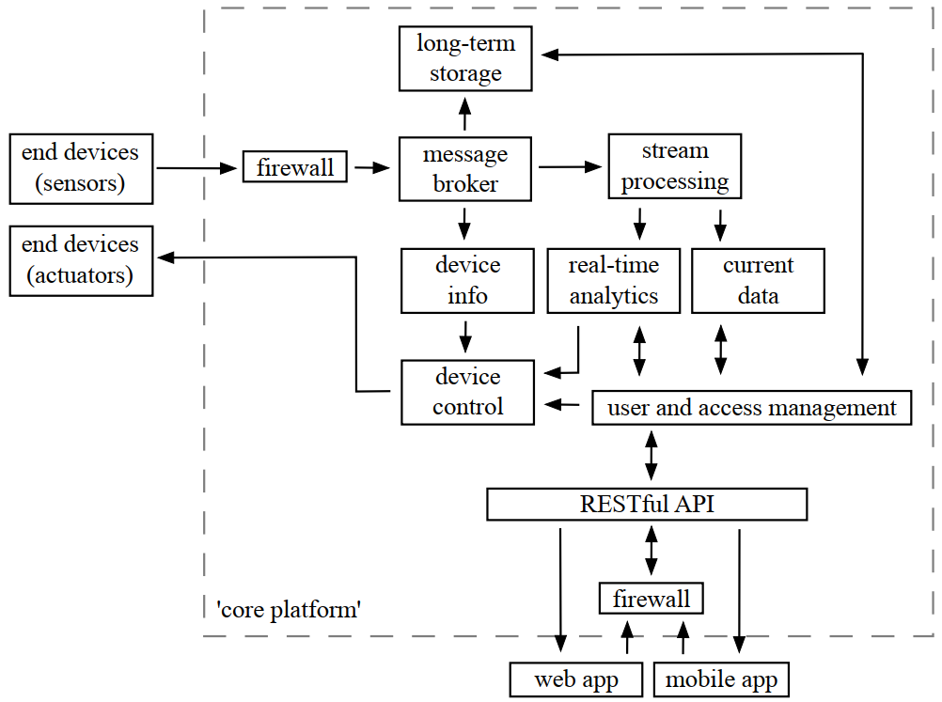
IoT platform

Slide 6
Message Handling layer
A message broker is an event-oriented middleware for the asynchronous routing of messages that is fed by IoT devices
The broker is at the core of many distributed backend systems such as IoT platforms
In the context of the IoT, a message broker is not only a module for internal communication, but also primarily responsible for data ingestion

Slide 7
Storage layer
Much of the data ingested from IoT devices may only be of immediate value
Some IoT data may be useful when agglomerated and analyzed over a longer period
Relational databases
NoSQL databases
Time-series databases

Slide 8
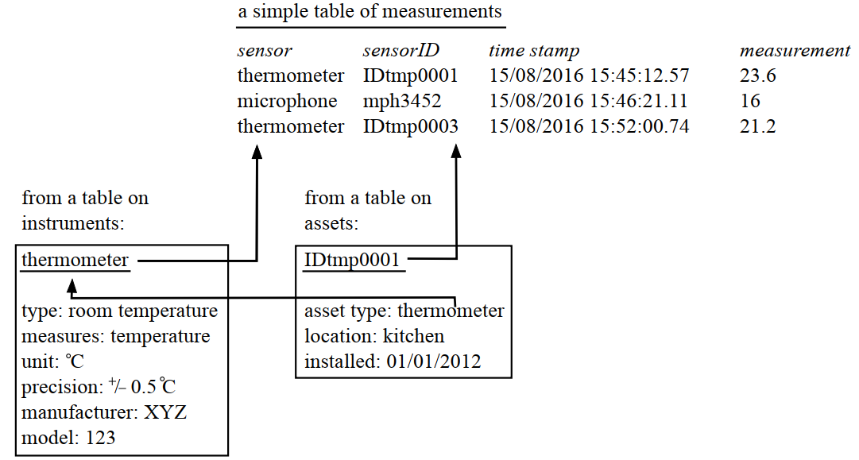
Relational databases

Slide 9
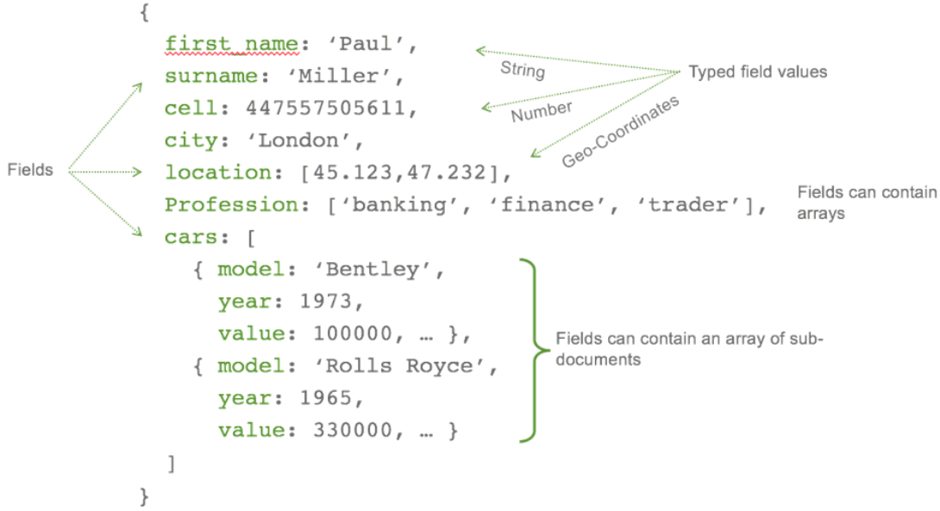
NoSQL databases
Key : value store (a hash, or dictionary)
Graph (key ! relationship ! value)
Tuple (more complex structures)

Slide 10
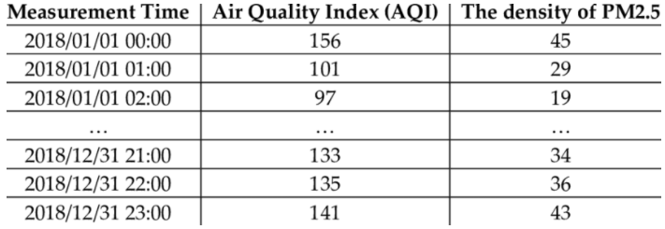
Time-series databases
Time-series databases often lend themselves to storing sensor measurements in an IoT backend, as every incoming value is associated with a time stamp

Slide 11
Big data
Five issues often invoked in the discussion of IoT data analytics are the:
Volume
Velocity
Variety
Veracity
Value
→Big data (5V)

Slide 12
Big data
Big data is data sets that have become so large and so complex that advanced programming and processing is required to capture the data, and then appropriately store, analyse, search, share, transfer, and visualise it.
Big data is significantly impacted by the growth of information-sensing Internet of Things devices

Slide 13
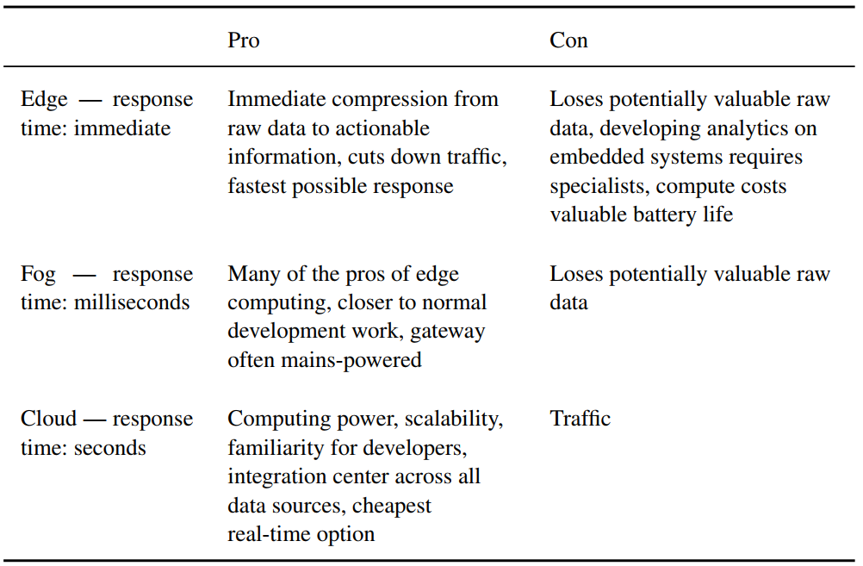
Computing demands

Slide 14
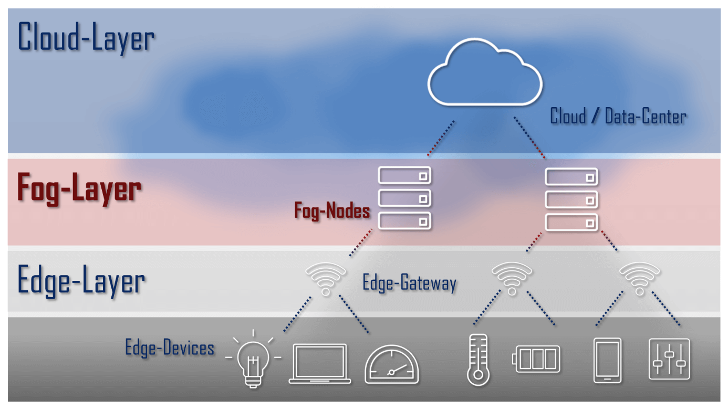
Computing demands

Slide 15
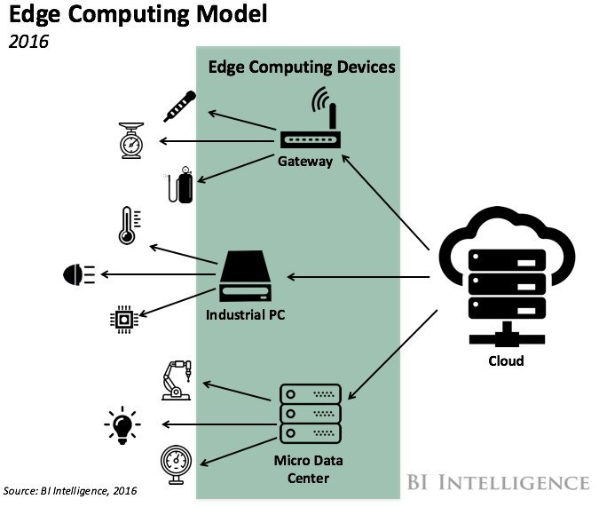
Edge computing

Slide 16
Data analysis
Cleansing and filter
Statistic
Machine Learning and AI (Artificial Intelligence)

